Slide 1


Oracle database
Lecture 29

Slide 2

Today’s Agenda
Introduction To View
Advantages Of View
Types Of View
Making Changes In The View
Using Special Clauses With The View
Restrictions On A Single View

Slide 3
Introduction To Views
A view is a virtual table that consists of columns and rows, but it is only the SELECT statement that is stored, not a physical table with data.
A view’s SELECT query may reference just one or multiple tables, called base tables.
The base tables are typically actual tables or other views.

Slide 4
Advantage Of Views
Views are beneficial in many ways to the programmer.
The most popular advantages of Views are :
Simplifying data retrieval.
Maintaining logical data independence.
Implementing data security.

Slide 5
Advantage Of Views
Simplifying Data Retrieval:
Views simplify the writing of queries.
We can query a view instead of writing a complicated SQL statement that joins many tables.
The complexity of the underlying SQL statement is hidden from the user and contained only in the view.

Slide 6
Advantage Of Views
Maintaining Data Independence
We can expose the data from underlying tables to the external applications via views.
Whenever the structures of the base tables change, we just need to update the view.
The interface between the database and the external applications remains intact. The beauty is that we don’t have to change a single line of code to keep the external applications up and running.

Slide 7
Advantage Of Views
Implementing Data Security
Views are useful for security reasons because they can hide data.
The data retrieved from a view can show only certain columns if we list those columns in the SELECT list of the query.
We can also restrict the view to display specific rows with the WHERE clause of the query.

Slide 8
Types Of Views
Oracle provides us the support for two types of Views called as SINGLE VIEW and JOIN VIEW.
A view created using a ONE BASE TABLE is called as a SINGLE VIEW while a view created using MULTIPLE BASE TABLE , for example a join query, is called a JOIN VIEW.

Slide 9
Syntax Of Single View
Important Point:
Creating a view is a special privilege
which must be assigned to our user
by the system user.
So before executing the
CREATE VIEW command we have
to execute the following
command from system user:
Grant Create View To OracleBatch;
CREATE VIEW view_name
As ( <select query> );
Example:
CREATE VIEW mystaff
As (Select ename,deptno from emp);

Slide 10
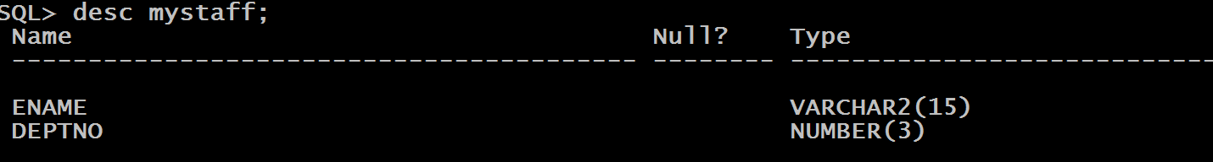
Describing The View
The MYSTAFF view hides a number of columns that exist in the EMP table.
We do not see the EMPNO and SAL columns and this is how views provide data security.

Slide 11
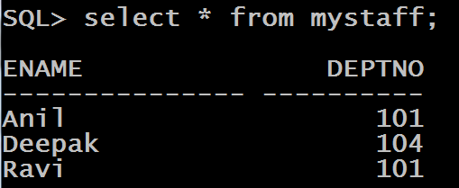
Selecting Data From View
We can now query view MYSTAFF as follows

Slide 12
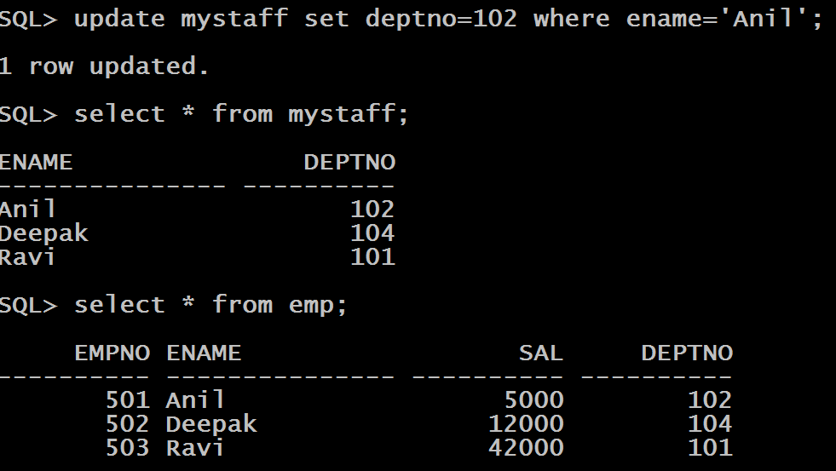
Executing DML Commands On View
UPDATING data in the view also updates data in the base table.

Slide 13
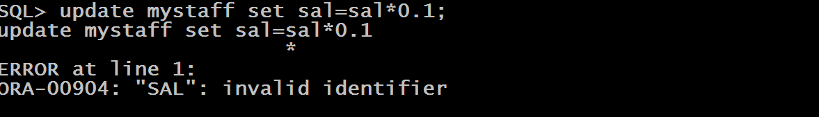
Executing DML Commands On View
However only those columns can be updated which are a part of the view.

Slide 14
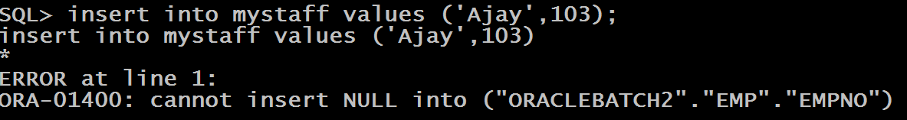
Executing DML Commands On View
We can INSERT data in the table through a view , but the columns which are not a part of view will receive NULL and if the table has a NOT NULL or PRIMARY KEY constraint enabled on that column then insertion will fail.

Slide 15
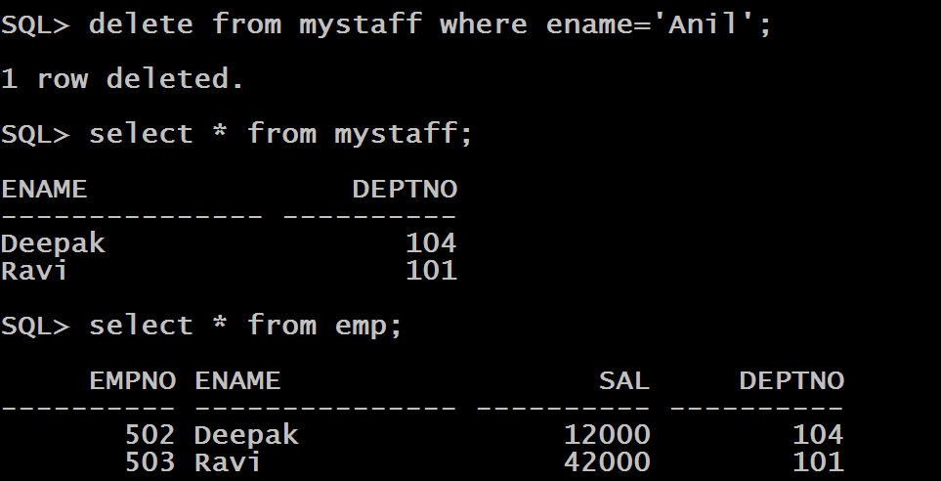
Executing DML Commands On View
DELETING data from a view actually deletes data from the base table

Slide 16
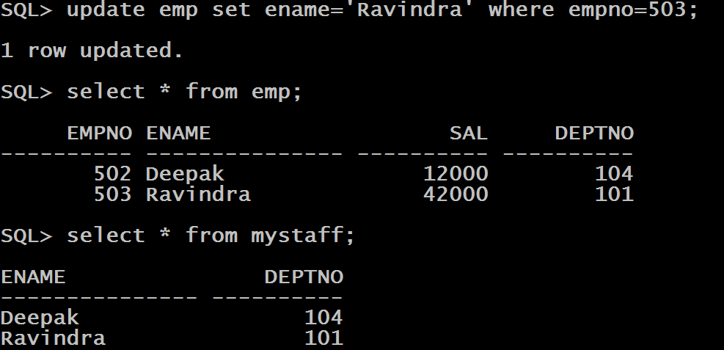
Making Changes In The Table
Changes made to the table are reflected in the view.

Slide 17
Clauses Used With Create View Command
OR REPLACE:
To overwrite an existing view Oracle provides us OR REPLACE clause which instructs Oracle to replace an existing view .
EXAMPLE:
CREATE OR REPLACE VIEW mystaff
As (Select * from emp where sal >15000);

Slide 18
Clauses Used With Create View Command
WITH CHECK OPTION:
The WITH CHECK OPTION clause protects the view from any changes to the underlying table that would produce rows which are not included in the defining query.
EXAMPLE:
CREATE OR REPLACE VIEW mystaff
As (Select * from emp where sal >15000) WITH CHECK OPTION;
Insert into mystaff values(504,’Gagan’,20000,101); // OK
Insert into mystaff values(505,’Kiran’,10000,102); // ERROR

Slide 19
Clauses Used With Create View Command
WITH READ ONLY:
The WITH READ ONLY clause prevents the underlying tables from changes through the view.
EXAMPLE:
CREATE OR REPLACE VIEW mystaff
As (Select * from emp where sal >15000) WITH READ ONLY;
Insert into mystaff values(504,’Gagan’,20000,101); // ERROR
Update mystaff set sal=sal*0.1; // ERROR

Slide 20
Clauses Used With Create View Command
FORCE:
Usually, we create a new view based on existing tables. However, sometimes, we may want to create a view based on the tables that we will create later. In these cases, we can use the FORCE option.
EXAMPLE:
CREATE FORCE VIEW mybooks
As (Select * from allbooks);

Slide 21
Restrictions On Single View
If a NOT NULL column that does not have a DEFAULT clause is omitted from the view, then a row cannot be inserted into the base table using the view.
If a view is defined with WITH CHECK OPTION, then a row cannot be inserted into, or updated in, the base table (using the view), if the view cannot select the row from the base table.
If a view is defined with WITH READ ONLY, then no DML operations are allowed on the view.
Views do not support DDL Commands

